Slide 1
Introduction to Dimensional Modeling I
Chapter 2 and Chapter 3

Slide 2
Dimensional Modeling Technique Overview
Gather Business Requirements and Data Realities
Understand the needs of the business, as well as the realities of the underlying source data, from:
key performance indicators;
compelling business issues;
decision-making processes;
supporting analytic needs;
By meeting with source system experts and doing high-level data profiling to assess data feasibilities.

Slide 3
Dimensional Modeling Technique Overview
Collaborative Dimensional Modeling Workshops
Dimensional models should be designed in collaboration with subject matter experts and data governance representatives from the business.
via interactive workshops with business representatives;

Slide 4
Dimensional Modeling Technique Overview
The four key decisions made during the design of a dimensional model:
Select the business process.
Declare the grain.
Identify the dimensions.
Identify the facts.

Slide 5
Business Processes
Business processes are the operational activities performed by the organization:
Taking an order;
Processing an insurance claim;
Registering students for a class;
Snapshotting every account each month.
Fact tables focus on the results of a single business process.
Business process defines a specific design target and allows the grain, dimensions, and facts to be declared.
Each business process corresponds to a row in the enterprise data warehouse bus matrix.

Slide 6
Grain
The grain establishes exactly what a single fact table row represents.
Atomic grain refers to the lowest level at which data is captured by a given business process.
Different grains must not be mixed in the same fact table.
The grain is determined by the physical realities of the operational system that captures the business process’s events.

Slide 7
Grain
Examples:
One row per scan of an individual product on a customer’s sales transaction;
One row per line item on a bill from a doctor;
One row per individual boarding pass scanned at an airport gate;
One row per daily snapshot of the inventory levels for each item in a warehouse;
One row per bank account each month;

Slide 8
Dimensions for Descriptive Context
Dimensions provide the “who, what, where, when, why, and how” context surrounding a business process event.
Examples: date, product, customer, employee, and facility;
With the choice of each dimension, you then list all the discrete, text-like attributes that flesh out each dimension table.
Dimension tables contain the descriptive attributes used by BI applications for filtering and grouping the facts.
Contain the entry points and descriptive labels that enable the DW/BI system to be leveraged for business analysis.

Slide 9
Facts for Measurements
Facts are the measurements that result from a business process event and are almost always numeric.
“What is the process measuring?”
A single fact table row has a one-to-one relationship to a measurement event as described by the fact table’s grain.
A fact table corresponds to a physical observable event.
Within a fact table, only facts consistent with the declared grain are allowed.
Typical facts are numeric additive figures, such as quantity ordered or dollar cost amount.

Slide 10
Retail Case Study
A large grocery chain has 100 grocery stores spread across five states.
Each store has a full complement of departments
Each store has approximately 60,000 individual products
Data is collected at
the cash registers as customers purchase products;
the store’s back door where vendors make deliveries;
At the grocery store, management is concerned with the logistics of ordering, stocking, and selling products while maximizing profit (pricing and promotions).

Slide 11
Retail Case Study
Step 1: Select the Business Process
To better understand customer purchases as captured by the POS system; Business process is POS retail sales transactions;
To analyze which products are selling in which stores on which days under what promotional conditions in which transactions;
Step 2: Declare the Grain
The most granular data is an individual product on a POS transaction, assuming the POS system rolls up all sales for a given product within a shopping cart into a single line item.

Slide 12
Retail Case Study
Step 3: Identify the Dimensions
Date, product, store, promotion, cashier, and method of payment.
Step 4: Identify the Facts
Sales quantity (for example, the number of cans of chicken noodle soup), price per unit regular, discount, and net paid prices, and extended discount and sales dollar amounts.
Extended sales dollar = the sales quantity *the net unit price.
Extended discount dollar = the sales quantity * the unit discount amount.

Slide 13
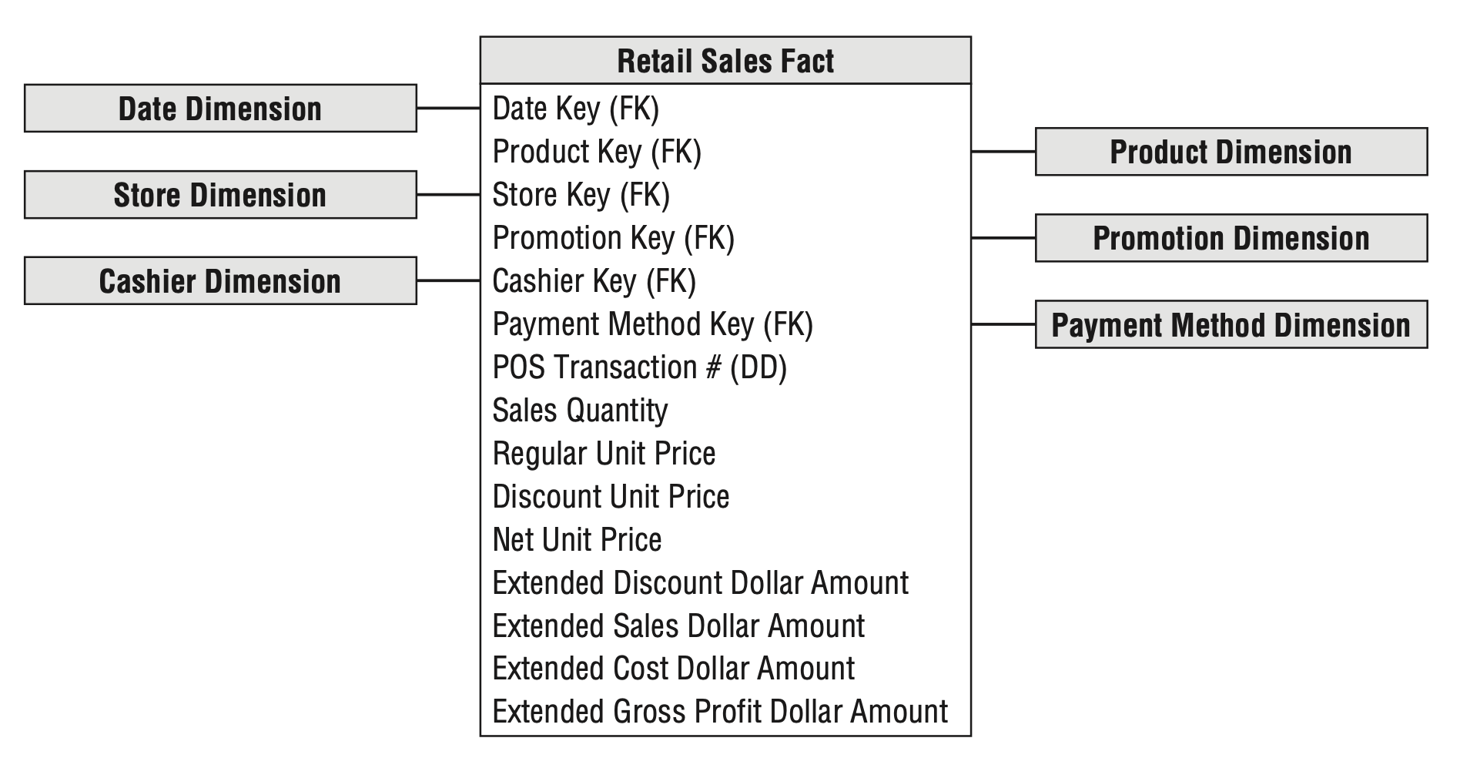
Retail Case Study

Slide 14
Retail Case Study
Transaction Fact Tables
The grain of atomic transaction fact tables express in the context of the transaction, such as one row per transaction or one row per transaction line.
Often sparsely populated.
Size is enormous.
Highly dimensional.
Additive

Slide 15
Basic Fact Table Techniques
Nulls in Fact Tables
Null-valued measurements behave gracefully in fact tables (SUM, COUNT, MIN, MAX, and AVG);
Nulls must be avoided in the fact table’s foreign keys;

Slide 16
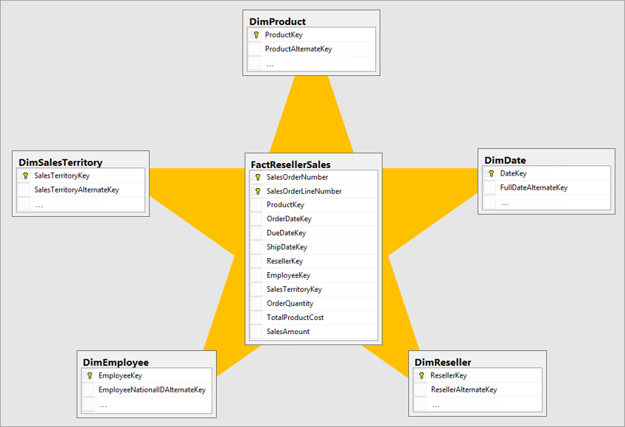
Star Schemas and OLAP Cubes
Star schemas
Dimensional structures deployed in a relational database management system (RDBMS);
Fact tables linked to associated dimension tables via primary/foreign key relationships.

Slide 17
Basic Fact Table Techniques
Fact Table Structure
A fact table contains the numeric measures produced by an operational measurement event in the real world.
A fact table always contains foreign keys for each of its associated dimensions;
Fact tables are the primary target of computations and dynamic aggregations arising from queries

Slide 18
Basic Fact Table Techniques
Additive, Semi-Additive, Non-Additive Facts
Additive: can be summed across any of the dimensions associated with the fact table;
Examples: quantity sold; total rs.sales;
Semi-additive: can be summed across some dimensions, but not all;
Balance amounts are common semi-additive facts because they are additive across all dimensions except time;
Non-additive:
Store the fully additive components of the non-additive measure and sum these components into the final answer set before calculating the final non-additive fact.
Examples: Averages (average sales price, unit price), Percentages (% discount), Ratios (gross margins), Count of distinct products sold;

Slide 19
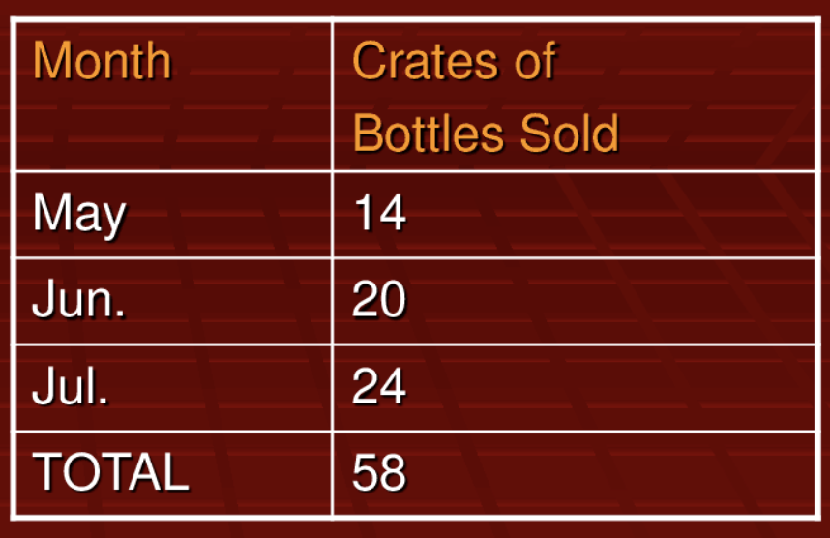
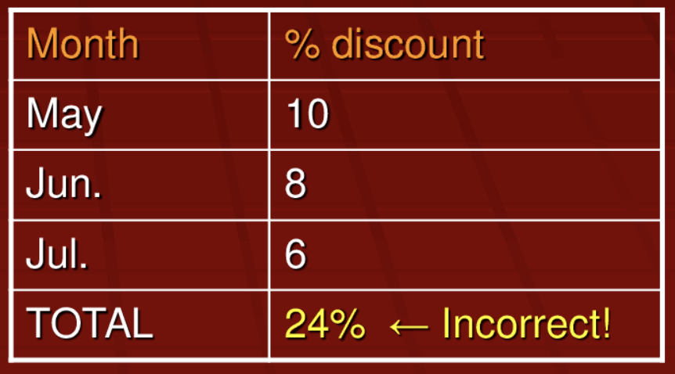
Additive Facts V.S. Non-Additive Facts
Additive Facts
Non-additive Facts

Slide 20
Retail Case Study
Derived Facts
the gross profit by subtracting the extended cost dollar amount from the extended sales dollar amount, or revenue.
Store the derived facts in the data warehouse would eliminate the possibility of user calculation errors;
Non-Additive Facts
Gross margin: gross profit/the extended sales dollar revenue;
Unit price;

Slide 21
Basic Fact Table Techniques
Factless Fact Tables
Used to analyze what didn’t happen.
Aggregate Fact Tables
Aggregate fact tables are simple numeric rollups of atomic fact table data built solely to accelerate query performance.

Slide 22
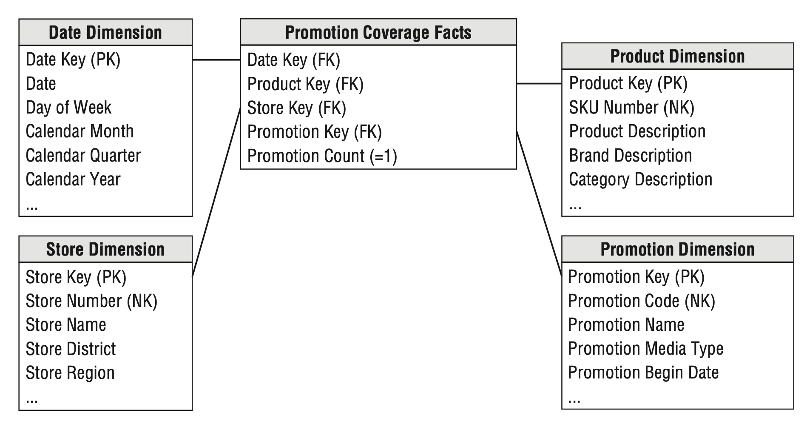
Retail Case Study
What products were on promotion but did not sell?
One row for each product on promotion in a store each day (or week, if retail promotions are a week in duration) regardless of whether the product sold;
The relationship between the keys as defined by a promotion, independent of other events;
No measurement metrics;

Slide 23
Promotion Dimension
Q: Which products were under promotion but did not sell?
Cannot answer! -> POS sales fact table has only products that were sold;
Factless Fact Table = has no measurement metrics -> determine what product where on promotion but did not sell;
2 step processes to answer Q
Query the promotion coverage table;
Determine what products sold from the POS sales fact table
The answer is the set difference between the 2 lists of products;

Slide 24
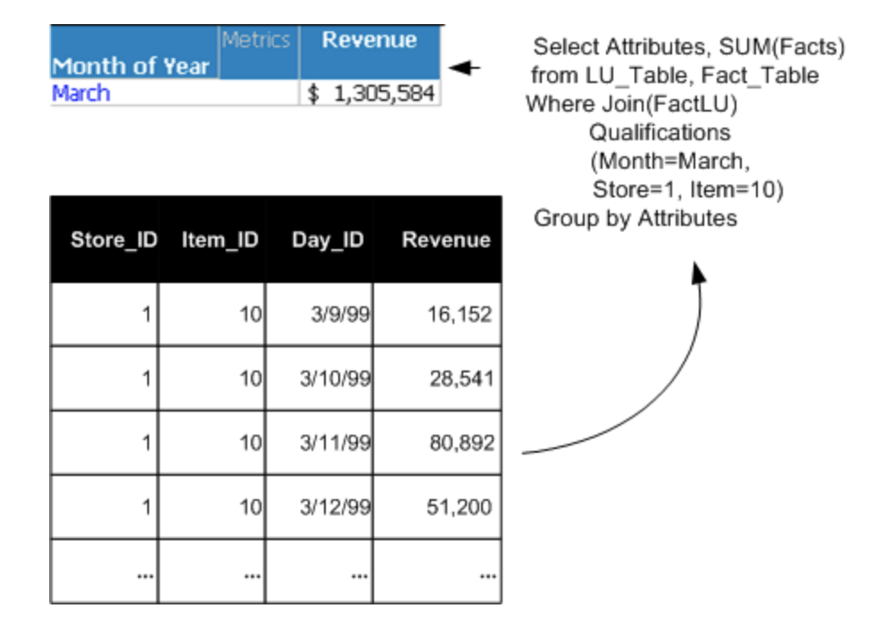
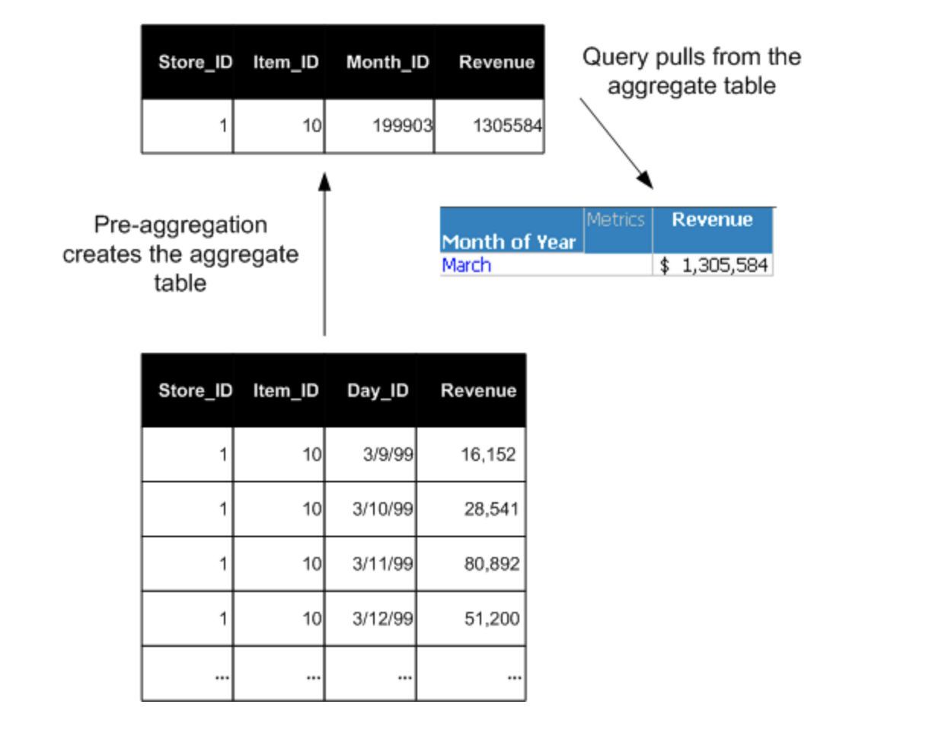
Aggregate Fact Tables Examples
Aggregation
Pre-aggregation

Slide 25
Basic Fact Table Techniques
Consolidated Fact Tables
Fact tables populated from different sources may potentially be consolidated into single one
Level of granularity must be the same
Measurements are listed side-by-side
Example: by combining forecast and actual sales amounts, a forecast/actual sales variance amount can be easily calculated and stored

Slide 26
Basic Dimension Table Techniques
Dimension Table Structure
Every dimension table has a single primary key column.
Dimension tables are usually wide, flat denormalized tables with many low-cardinality text attributes.
The most powerful dimension attributes are populated with verbose descriptions.
Dimension table attributes are the primary target of constraints and grouping specifications from queries and BI applications.

Slide 27
Basic Dimension Table Techniques
Dimension Surrogate Keys
A dimension table is designed with one column serving as a unique primary key.
Natural keys for a dimension may be incompatible or poorly administered.
Create anonymous integer primary keys for every dimension: dimension surrogate keys are simple integers, assigned in sequence, starting with the value 1, every time a new key is needed.
The date dimension is exempt from the surrogate key rule;

Slide 28
Basic Dimension Table Techniques
Natural, Durable Keys
Natural keys created by operational source systems are subject to business rules outside the control of the DW/BI system.
Durable keys are mandatory for dealing with ambiguities in the source system natural keys.
Independent of the original business process and thus should be simple integers assigned in sequence beginning with 1;
Multiple surrogate keys may be associated with an employee over time as their profile changes, the durable key never changes;

Slide 29
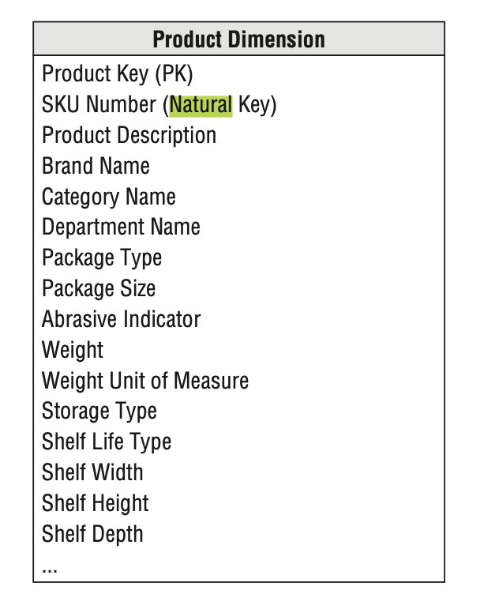
Retail Case Study
Primary Key and Natural Key

Slide 30
Basic Dimension Table Techniques
Drilling Down
Adding a row header to an existing query;
The new row header is a dimension attribute appended to the GROUP BY expression in an SQL query;
The attribute can come from any dimension attached to the fact table in the query.

Slide 31
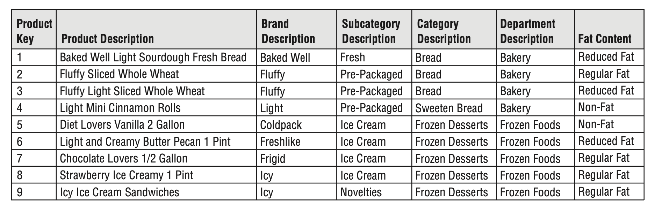
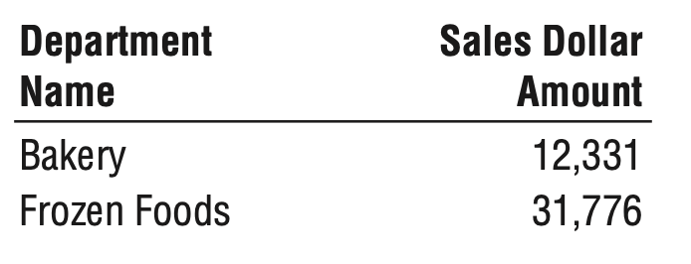
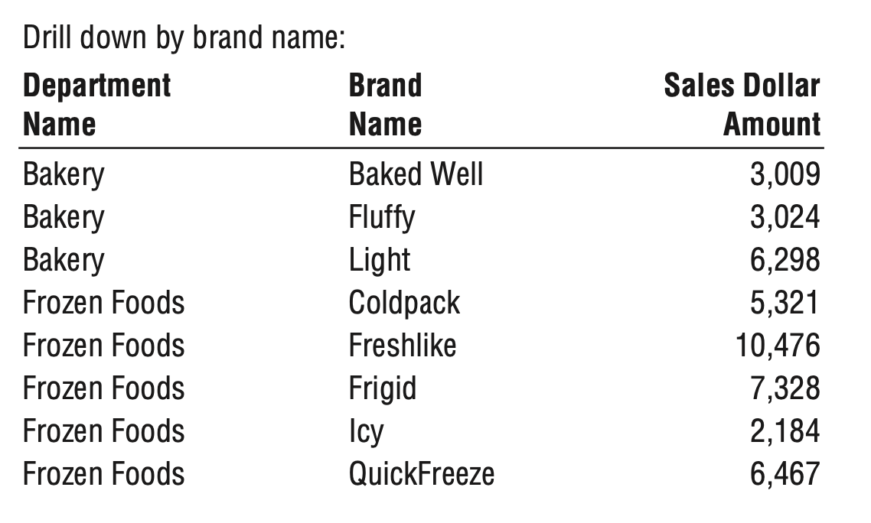
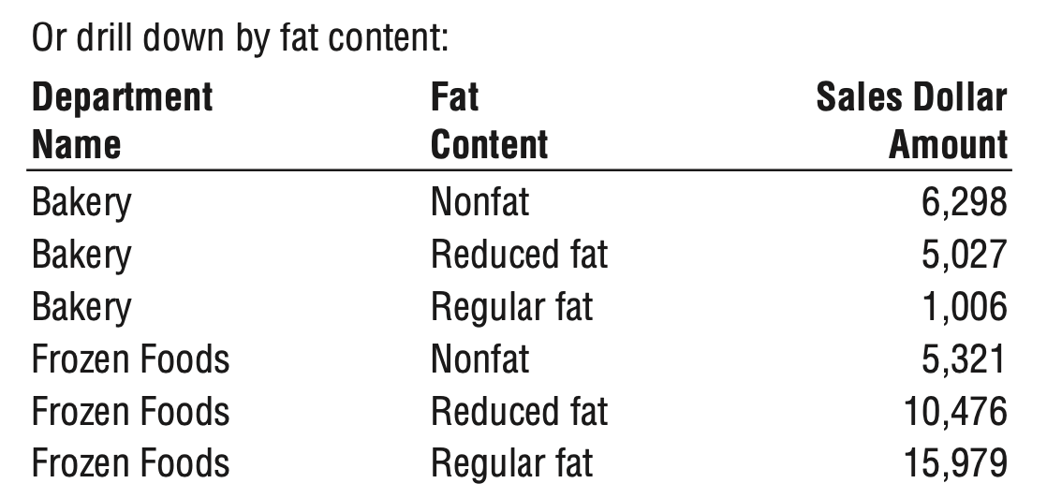
Retail Case Study

Slide 32
Basic Dimension Table Techniques
Degenerate Dimensions
Degenerate dimension is placed in the fact table that there is no associated dimension table.
Denormalized Flattened Dimensions
Denormalize the many-to-one fixed depth hierarchies into separate attributes on a flattened dimension row.

Slide 33
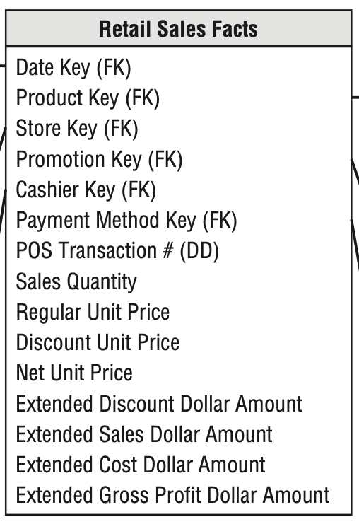
Retail Case Study
Degenerate Dimensions for Transaction Numbers
The retail sales fact table includes the POS transaction number on every line item row.
In the DBMS, POS transaction number is key to the transaction records;
In the dimensional model, POS transaction number is used for (1) grouping key; (2) track back to the operating system;
Denoted as degenerate dimension (DD)

Slide 34
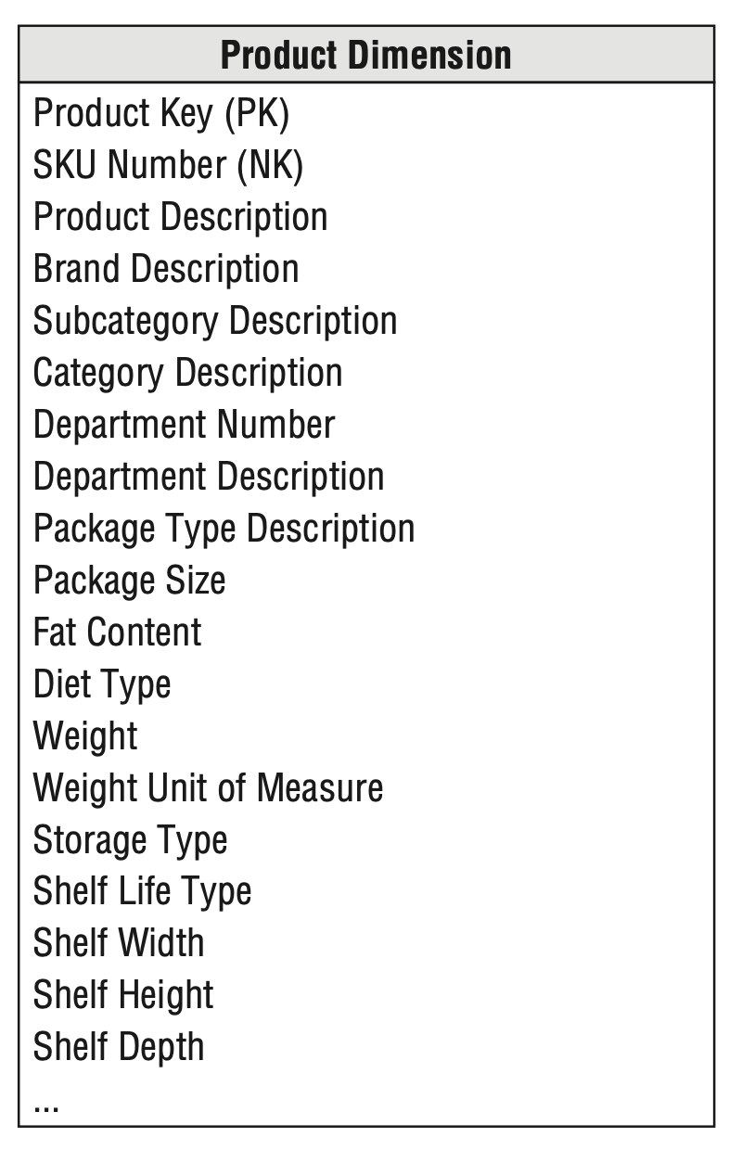
Retail Case Study
Product Demission

Slide 35
Basic Dimension Table Techniques
Multiple Hierarchies in Dimensions
Many dimensions contain more than one natural hierarchy.
A day to week to fiscal period hierarchy or a day to month to year hierarchy.
The separate hierarchies can coexist in the same dimension table.
Flags and Indicators as Textual Attributes
Cryptic abbreviations, true/false flags, and operational indicators;
Be supplemented in dimension tables with full text words;

Slide 36
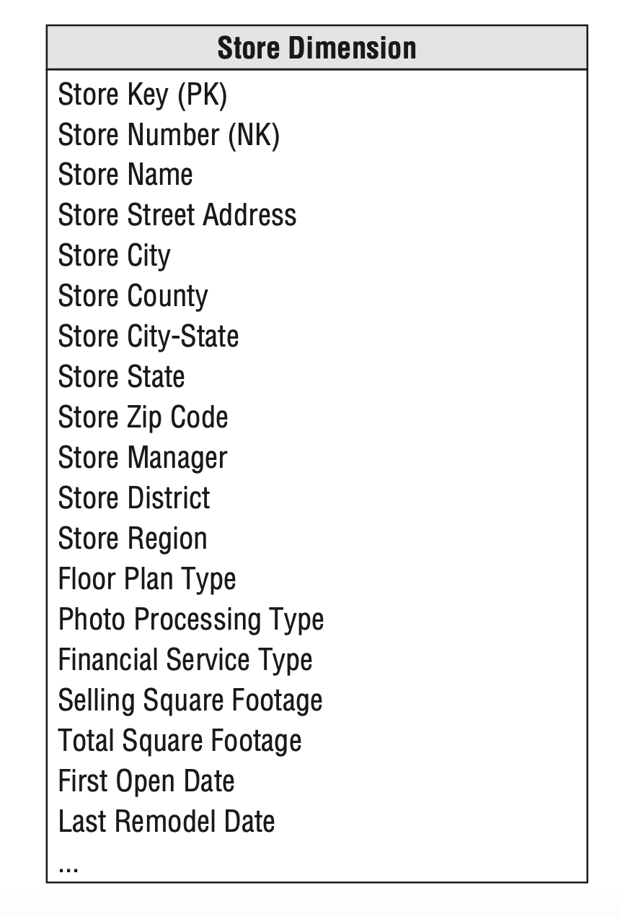
Retail Case Study
Store Dimension
Describe every store in grocery chain;
Possible to represent multiple hierarchies in a dimension table;

Slide 37
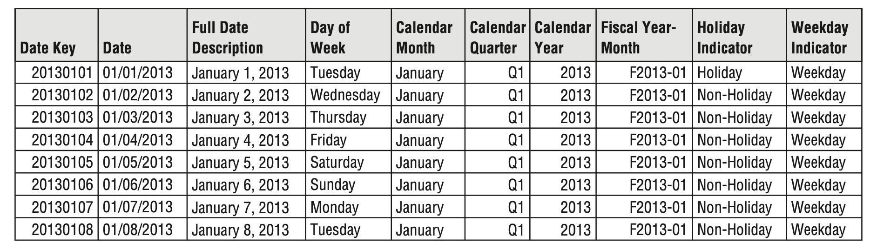
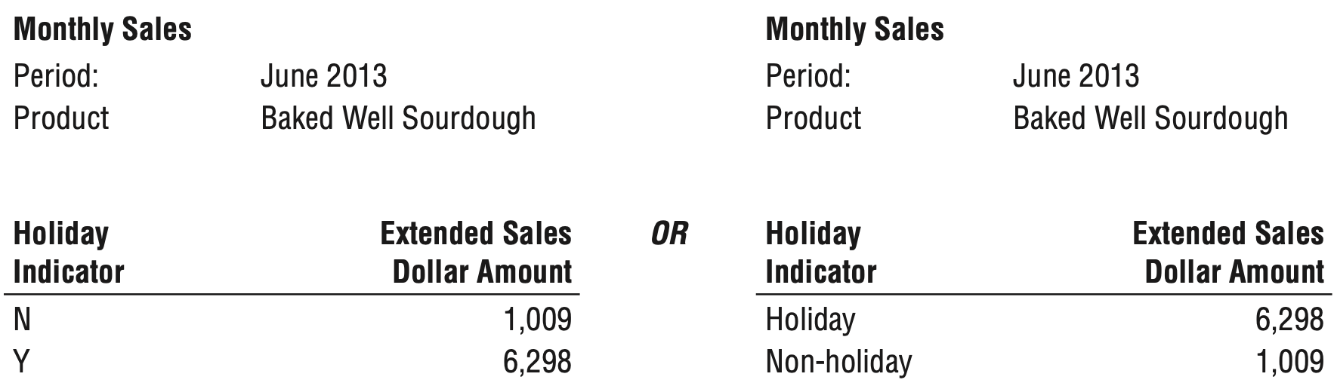
Retail Case Study

Slide 38
Basic Dimension Table Techniques
Null Attributes in Dimensions
When a given dimension row has not been fully populated;
When there are attributes that are not applicable to all the dimension’s rows;
Unknown or Not Applicable
Nulls in dimension attributes should be avoided

Slide 39
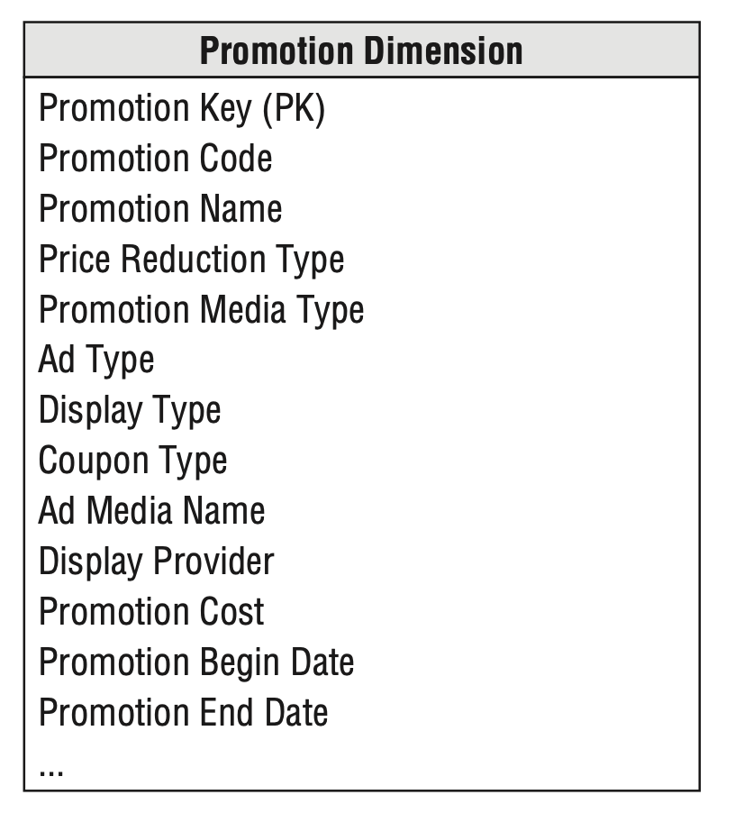
Retail Case Study
Promotion Dimension
Many sales transactions include products that are not being promoted;
The promotion dimension must include a row, with a unique key such as 0 or –1;

Slide 40
Basic Dimension Table Techniques
Calendar Date Dimensions
Calendar date dimensions are attached to virtually every fact table to allow navigation of the fact table through dates, months, fiscal periods, and special days on the calendar.
Attributes describing characteristics such as week number, month name, fiscal period, and national holiday indicator.
Primary key: YYYYMMDD;
A special row to represent unknown or to-be-determined dates;
Sometimes, add a separate time-of-day dimension foreign key to the fact table;

Slide 41
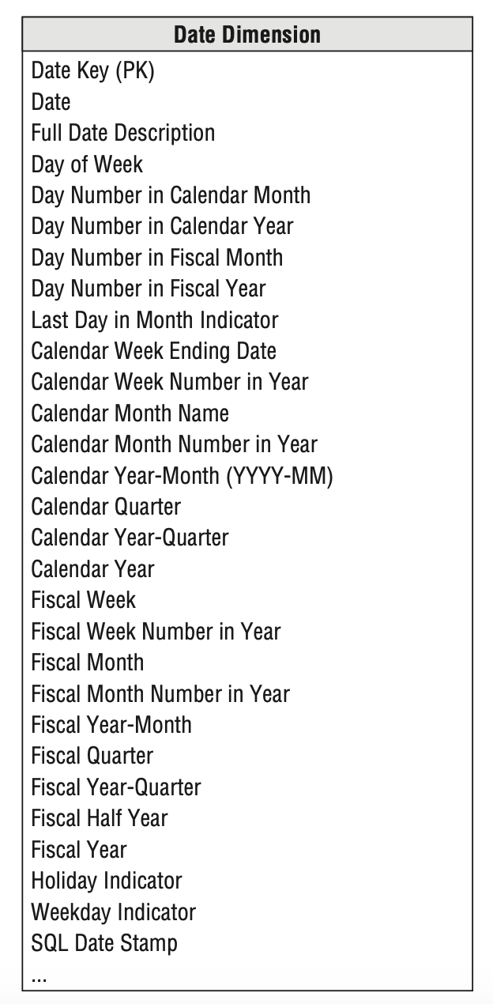
Retail Case Study
Date Demission:

Slide 42
Date Dimension
Associated with almost every fact table;
User verbose -> self-explanatory values rather than codes values
Ex. Holiday indicator by using holiday and nonholiday instead of using Y and N;
Date Key should be integer rather than date type;
If transaction time is of interest -> Time dimensional table;

Slide 43
Date Dimension
Why explicit date dimension table is needed?
(1). Because relational database cannot handle an efficient join to the date dimension table;
(2). Because most database do not index SQL date calculation;

